Slide 1
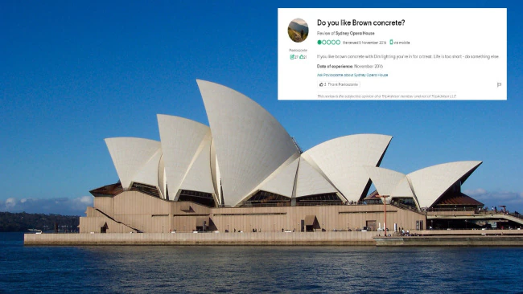
Notes:
In 2016 user Pavloszante was bitterly disappointed by the architectural icon that is the Sydney Opera House. In his no nonsense appraisal he writes: "If you like brown concrete with Dim lighting you're in for a treat. Life is too short - do something else."

Slide 2
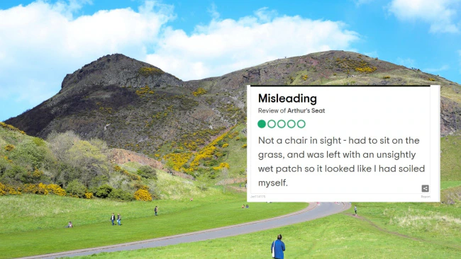
Notes:
That is a profound review of Arthur's Seat in Scotland.

Slide 3
Notes:
Irish Tripadvisor user Woodywoodpecker51 was seriously underwhelmed by the Great Wall of China. His review titled "Too long, I didn't even bother" reads "Ok, I built a just wall... SO? Why should I be impressed. Back in my days the walls where more beautiful and they didn't have to be so tall. Come one!? I didn't feel good with my leg that day, and my wife really wanted to visit all the Chinese Wall and I said "Ok, let's do it!", but I soon understood that it was definitely too long for me and I got tired. I failed in front of my wife because of this wall, so I'm not gonna be back there." (sic)

Slide 4
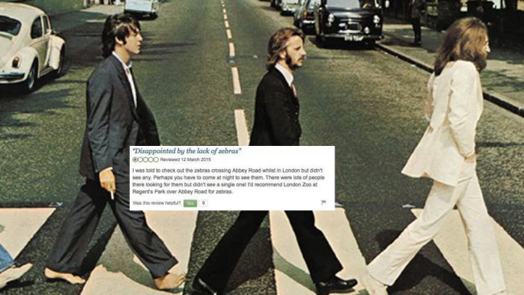
Notes:
In 2015 when this person visited the iconic Abbey Road in London, they were decidedly unimpressed. "I was told to check out the zebras crossing Abbey Road whilst in London, but didn't see any," they wrote. "Perhaps you have to come at night to see them. There were lots of people there looking for them but didn't see a single one! I'd recommend London Zoo at Regent's Park over Abbey Road for zebras".

Slide 5
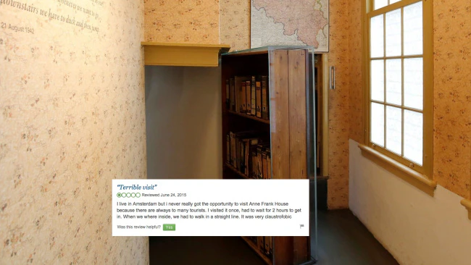
Notes:
In 2014 a resident of Amsterdam was highly critical of one of her city's tourist attractions. In fact, she had a "terrible visit". Her review reads: "I live in Amsterdam but i never really got the opportunity to visit Anne Frank House because there are always to many tourists. I visited it once, had to wait for 2 hours to get in. When we where inside, we had to walk in a straight line. It was very claustrofobic".

Slide 6
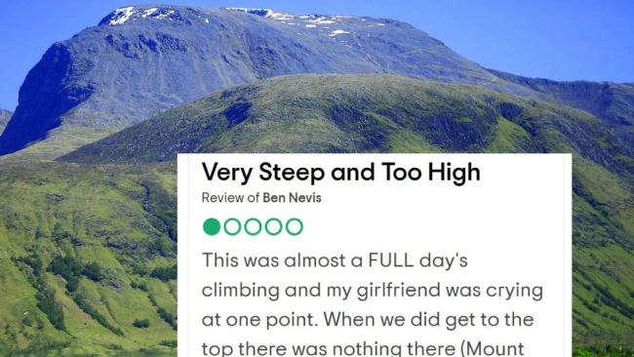
Notes:
Of Ben Nevis in Scotland, this reviewer wrote "This was almost a FULL day's climbing and my girlfriend was crying at one point. When we did get to the top there was nothing there (Mount Snowdon has a pub, restaurant and toilets at its top). Luckily we had brought some sandwiches and drinks, so anyone else climbing this one - BE WARNED- there are NO facilities at the top. The climb basically went on for far too long and the last part was particularly steep and difficult. It was also cloudy at the top so the view was non-existent. The long walk back down was boring and again took too long."

Slide 7
Notes:
In 2013 user milo123456 (get those characters in that username, baby!) did not have a great time at New York's Central Park. In his missive titled "just some grass and trees" he complained: "just grass, trees, overpriced cafees. Surrounded by buildings in a square. Filmed from a helicopter it might be interresting, but you will not be able unless you have military permission. Booring."

Slide 8
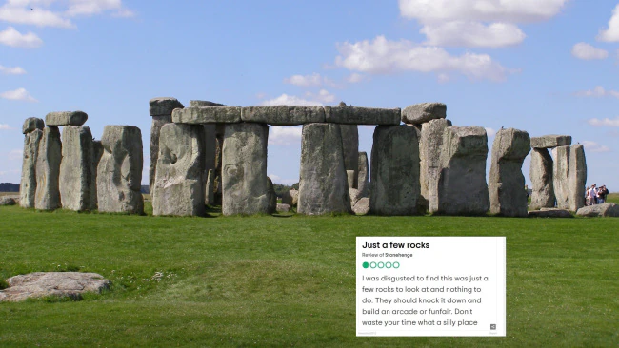
Notes:
Of Stonehenge in the UK, user HonestLocal2012 wrote "I was disgusted to find this was just a few rocks to look at and nothing to do. They should knock it down and build an arcade or funfair. Don't waste your time what a silly place".

