Slide 1
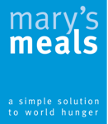

Making a difference.
This session will be based on ‘Stewardship’
and the charity “Mary’s Meals”.
There will be notes accompanying some slides to help guide you
and contextualise certain activities.
(The 'Notes' tab at the bottom of the screen.)
“Each of you should use whatever gift you have received to serve others, as faithful stewards of God’s grace in its various forms.”
- 1 Peter 4:10
Notes:
WITH REGARDS TO THE SCRIPTURE QUOTE ON THIS SLIDE, YOU MAY WANT TO DISCUSS SOME/ALL OF THE FOLLOWING:
Encouraging young people to begin to think about the God-given gifts and talents that they have and how they can use these to make a difference in the world.
Identifying the more “every day” talents – listening, supporting, being a friend etc.
Taking time to reflect upon how we can recognise where God wants us to use those talents to make a difference.

Slide 2
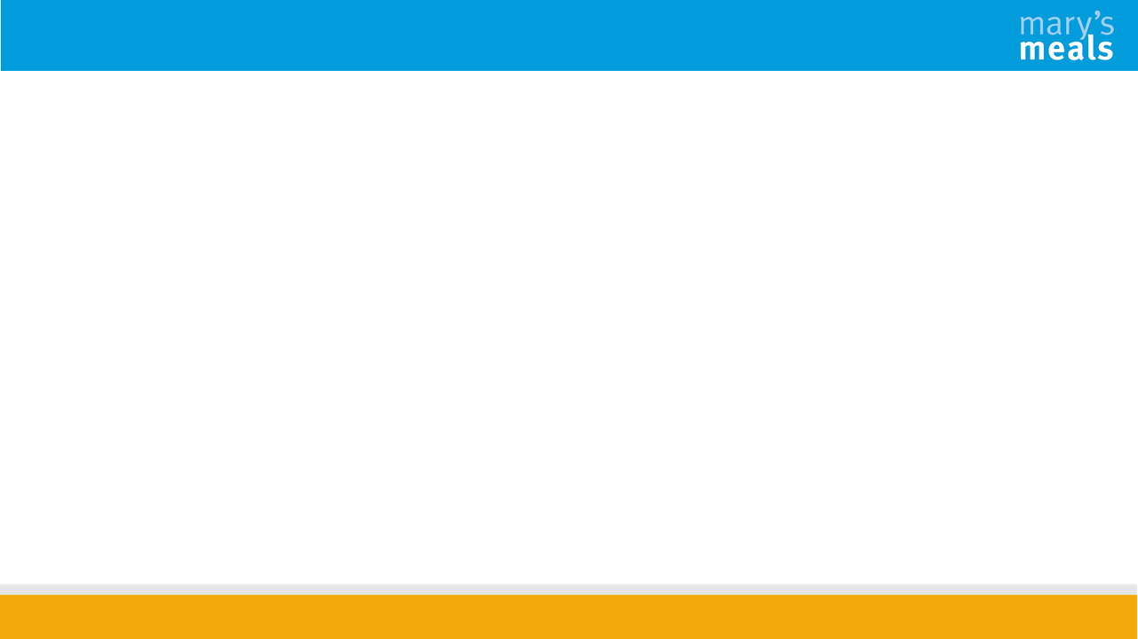
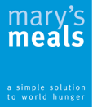
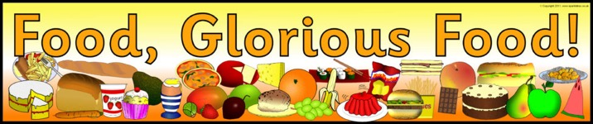

Find
Find a partner and take it in turns to answer the question that will be read out
Move
When the leader shouts change, move to a different partner and answer the next question that will be read out
Continue
Continue to change partners each time a new question is asked
Notes:
What's the strangest thing you've ever eaten? ...
Share an unusual food pairing that you love. ...
If you could only eat one food for the rest of your life, what would it be, and why? ...
What's something that you ate regularly as a family growing up? ...
What's a food that you keep trying to like, but just can't?

Slide 3
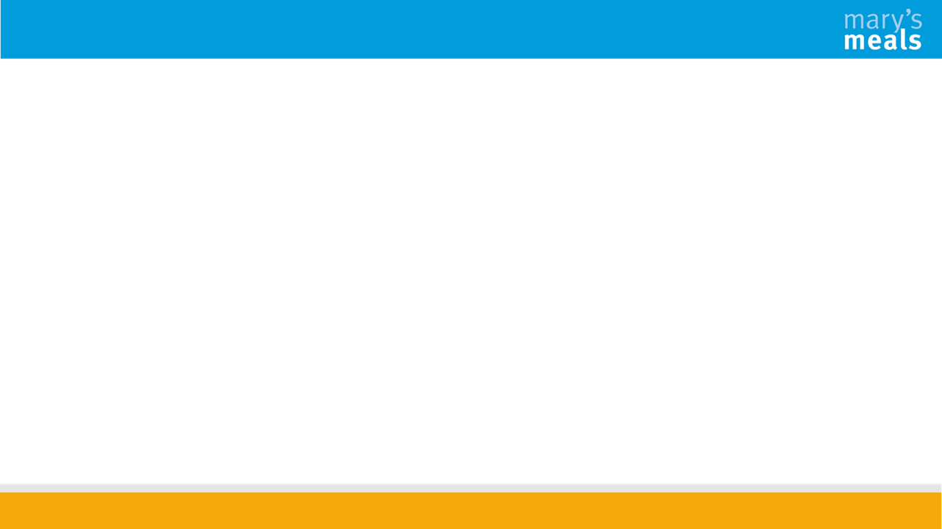
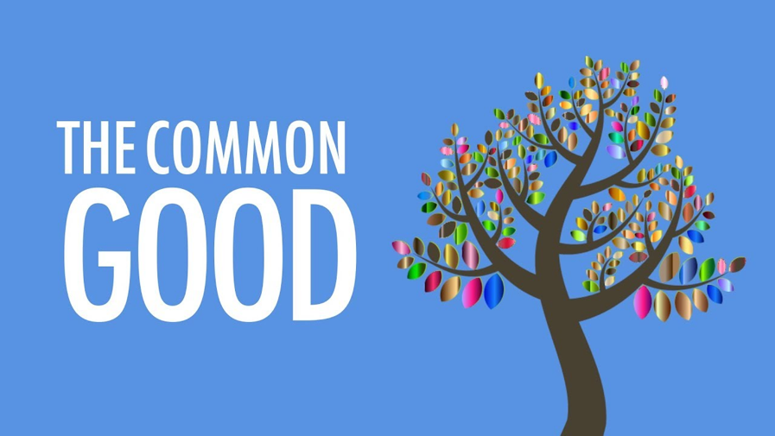
Notes:
What does this mean?
That what God has given us on this earth belongs to everyone. Everyone has the right to benefit from these gifts and working together we can achieve this for all. This will ensure the improvement of the wellbeing of those in our society and the wider world.

Slide 4
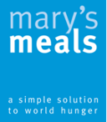
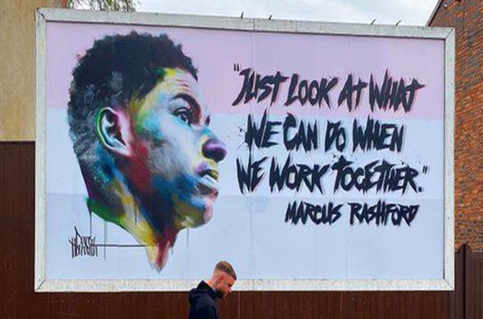
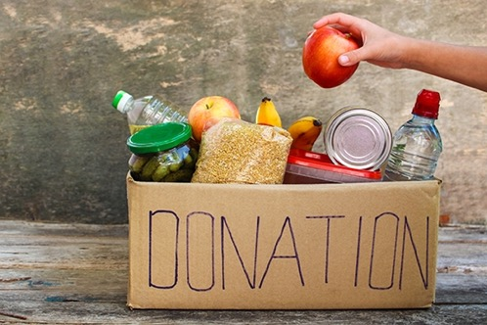
Notes:
We are all very aware that during the pandemic, for example, many people stepped forward to help those around them who were struggling to buy food. This is one example of serving the Common Good. Many others have continued to do this before and after the pandemic, helping at foodbanks, soup kitchens, homeless shelters and many other organisations.

Slide 5
What does the church say about the Common Good?
“It is necessary that all participate, each according to their position and role, in promoting the common good. This obligation is inherent in the dignity of the human person.”
CCC 1913
Notes:
Discuss and explain:
What does this mean?
That we all have a duty in whatever circumstances we find ourselves to speak out and tell others about the common good. This is something that every human being should do.

Slide 6
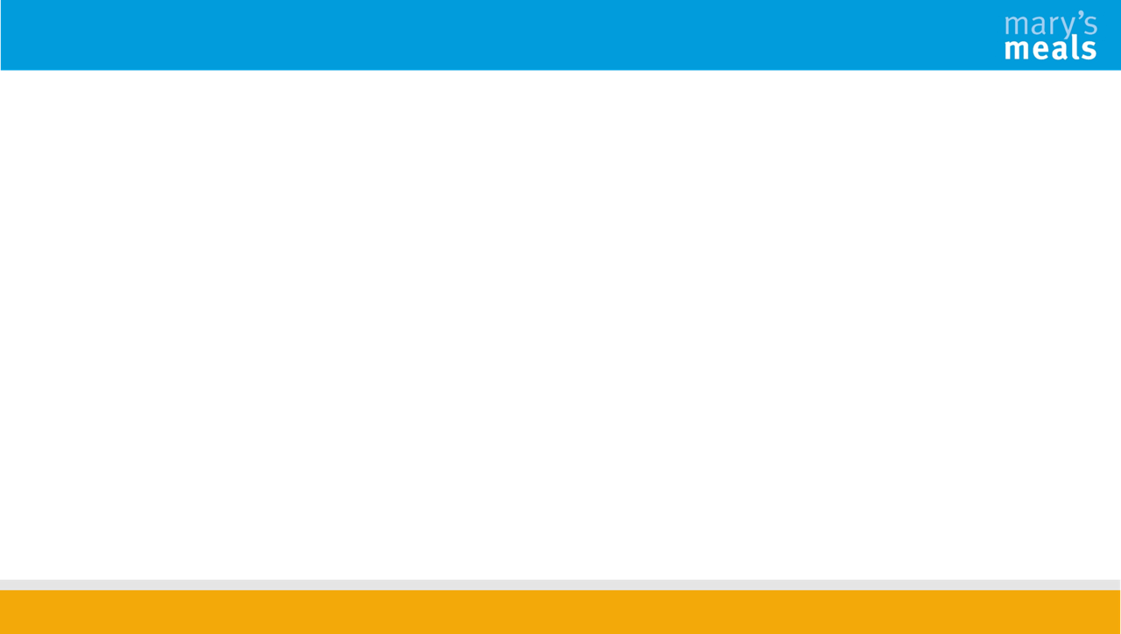
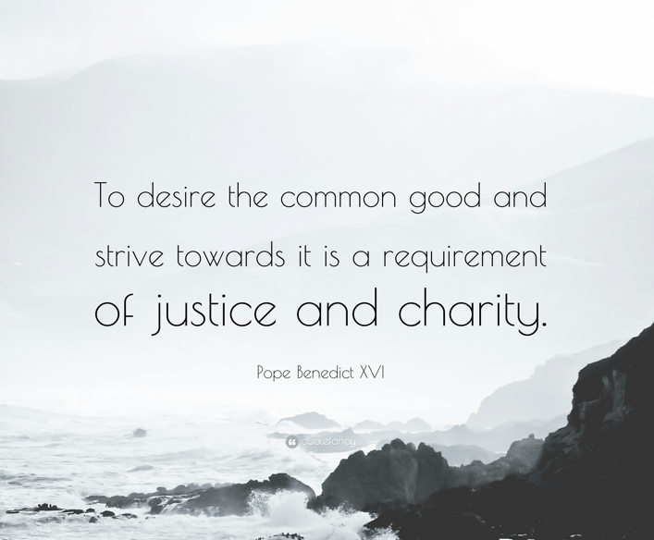
What does the church say about the Common Good?
Notes:
Discuss and explain:
What does this mean?
That we have not only a duty as individuals but as communities/societies to want the best for everyone and to work together to make sure that this happens to ensure we live in a just and caring world.

Slide 7

Can you think of any examples of people who have served the common good during their lifetime?

Slide 8

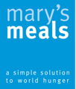

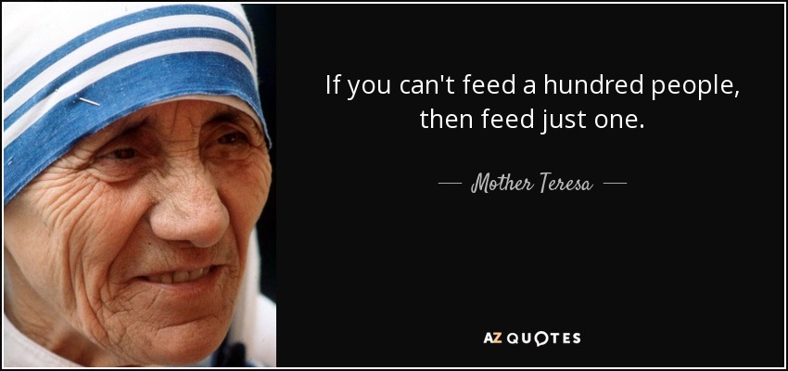

St Teresa of Calcutta
Born in 1910 in Skopje, North Macedonia
Died in 1997 in Calcutta, India
Patron saint of World Youth Day, Missionaries of Charity and is a co-patron of the Archdiocese of Calcutta, alongside St Francis Xavier

Slide 9

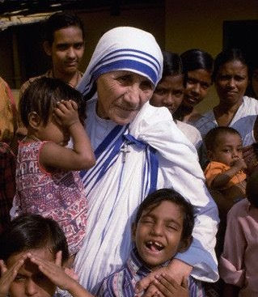

St Teresa of Calcutta
Born Agnes Gonxha Bojaxhiu in Skopje, she moved to Ireland at the age of 18 and then to India where she lived for most of her life.
She wanted to pursue missionary work and joined the Sisters of Loreto, receiving the name Sister Mary Teresa after St. Therese of Lisieux.
In 1929, she travelled to India and after making her First Profession of Vows, Sister Teresa was assigned to the Loreto Entally community in Calcutta where she taught at St. Mary's School for girls, becoming the school's principal in 1944.

Slide 10

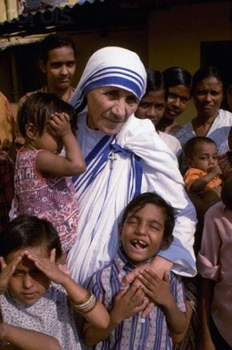

St Teresa of Calcutta
It was on September 10, 1946 during a train ride from Calcutta to Darjeeling for her annual retreat, that Mother Teresa (as she was then known) received her "inspiration, her call within a call." On that day, in a way she would never explain, Jesus' thirst for love and for souls took hold of her heart and became the driving force of her life.
In 1950, Teresa founded the Missionaries of Charity, a Roman Catholic religious congregation that had over 5,000 nuns and is active in 133 countries. The congregation manages homes for people who are dying of HIV/AIDS, leprosy and tuberculosis. It also runs soup kitchens, dispensaries, mobile clinics, children's and family counselling programmes, as well as orphanages and schools. Members take vows of chastity, poverty, and obedience, and also profess a fourth vow – to give "wholehearted free service to the poorest of the poor."

Slide 11


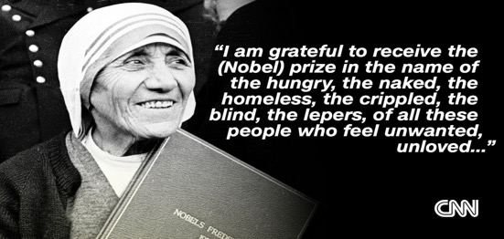

St Teresa of Calcutta
Mother Teresa received a number of honours, including the 1962 Ramon Magsaysay Peace Prize and the 1979 Nobel Peace Prize.
She was canonised on 4th September 2016, and the anniversary of her death, 5th September, is her feast day.

Slide 12
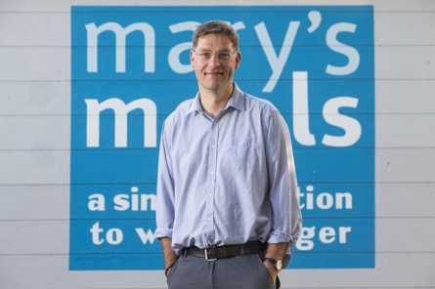

Magnus MacFarlane Barrow
Magnus was born in Aberdeen in 1968 but has lived in Argyll, in the Scottish Highlands, since the age of nine and began his career as a fish farmer.
He was named one of 2010's ‘Top 10 Heroes’ by broadcaster CNN and received an OBE in the 2011 New Year’s Honours list. Magnus has also been awarded Honorary Degrees by the University of Stirling, Glasgow Caledonian University and the University of Hull.
Before Mary’s Meals, Magnus played shinty for Glenorchy Camanachd Club and was capped four times by Scotland at senior international level.
Magnus is married to Julie, a trained nurse from Inverness. She became his co-driver on some of the first deliveries of aid to Bosnia-Herzegovina in 1993 and has been devoted to the charity ever since. They live in Dalmally with their seven children.

Slide 13

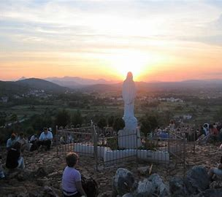
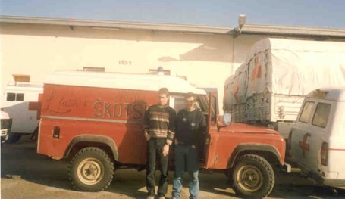
The Mary’s Meals Story
When Magnus was a teenager, a pilgrimage to the Marian shrine of Medjugorje in Bosnia-Herzegovina renewed his families’ Catholic faith and led Magnus' parents to convert their guest house into a retreat centre, Craig Lodge Family House of Prayer
1992 – When the Bosnian conflict was making headlines in the early 1990s, Magnus and his brother Fergus were moved to launch an appeal for aid. Their local community responded generously and the brothers drove these 1st donations out to Medjugorje in an old, borrowed Land Rover.

Slide 14
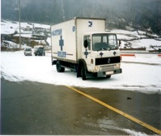
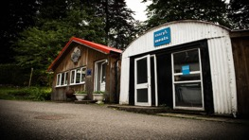
The Mary’s Meals Story
When they returned to Dalmally,
the donations continued to pour in.
Magnus decided to leave his job as a salmon farmer and continued to drive aid to Bosnia.
This work became registered as an official charity, Scottish International Relief.

Slide 15
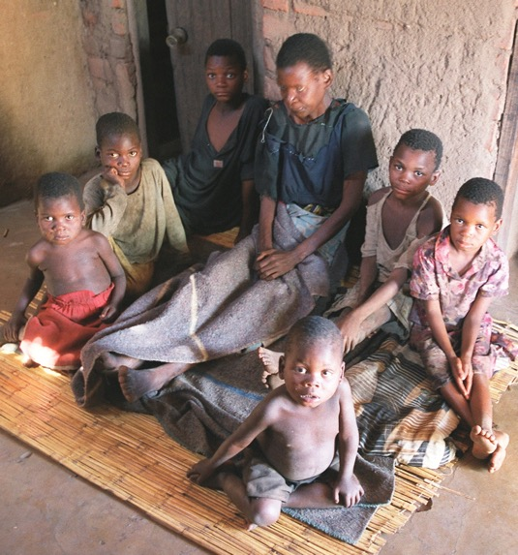
The Mary’s Meals Story
2002 – Magnus was in Malawi and met Emma, a young mother of 6 children, who was dying of aids. He asked her eldest son, Edward, who was aged 14, what he hoped for in life.
Edward answered:
"to have enough to eat and to go to school
one day“.

Slide 16
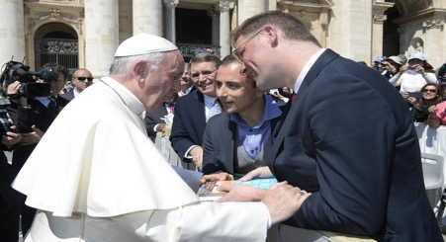
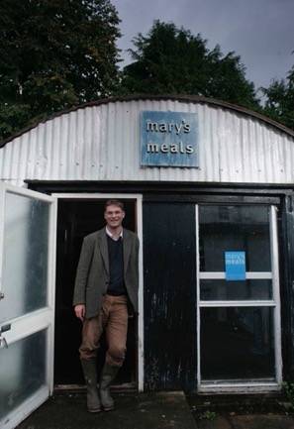
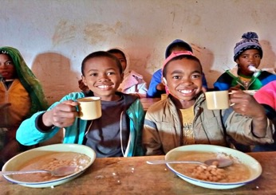
The Mary’s Meals Story
This sparked the campaign Mary's Meals, which began by feeding 200 children in a school in Malawi.
In 2012 SIR officially changed its name to Mary's Meals.
Today, Mary’s Meals is now reaching over 2,000,000 children in 19 countries
every school day!

Slide 17
https://www.youtube.com/watch?v=uMhHAINVW0A
– From Hunger to Hope
Notes:
This video can be used with discussion afterwards if a speaker isn’t present from the charity.

Slide 18
Discussion Questions
Do you remember a time when you didn’t feel able to do something because you were hungry? How did you feel and how did it effect you?
Can you think about some of the reasons why so many poor children remain out of school or unable to learn?
How does the work of Mary’s Meals respect the dignity and worth of individuals in local communities involved in their feeding programmes? Why do you think their methods are effective?
How are the actions of the Missionaries of Charity and Mary’s Meals living out “Faith in Action”?

Slide 19


Journal Time
How have the stories of St Teresa of Calcutta and Mary’s Meals inspired you today in your Faith in Action journey?
List some ways you could get involved with Mary’s Meals as part of your award.
Write about all of this in your journal.

Slide 20
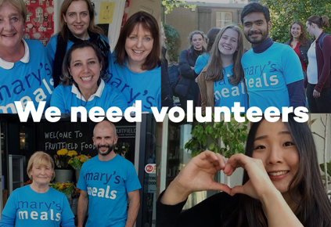
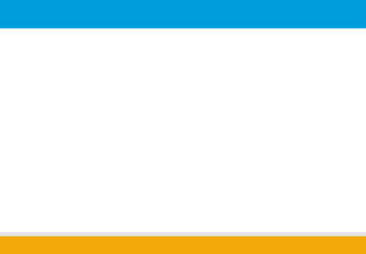

Become a Youth Ambassador
Youth Ambassador Programme (age 14-21)​
- please visit our website for more information about how becoming a Youth Ambassador for Mary’s Meals can help you with your ​
Faith in Action award.​

Slide 21

Reflection
How have you served
the common good
in your life?

Slide 22
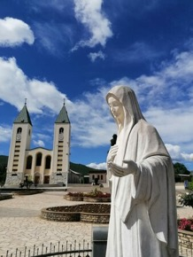
Mary’s Meals prayer
Our Father
give us this day our daily bread
and forgive us for the times when we take more
than our share of the bread that belongs to all.
Let us help You fill the starving with good things,
not with scraps from our table.
Teach us how to share what is not ours to keep.
Clothe us with Your love
that we may complete each good work
you created us to do.
Place in our hearts
Your compassion for each starving child
and use our little acts of love
so that they starve no more.
Amen.

