Slide 1
The way, the truth and the life.
This session will be based on 'Pilgrimage'. There will be notes accompanying some slides to help guide you and contextualise certain activities.
(The 'Notes' tab at the bottom of the screen.)
“You will seek me and find me, when you seek me with all your heart.”
- Jeremiah 29:13

Slide 2
In small groups, each person takes it in turns to say three things, two of them being true and one being a lie.
The rest of the group must guess which is the lie.

Slide 3
PILGRIMAGE
What does the word ‘pilgrimage’ mean to you?
1: A journey, especially a long one, made to some sacred place as an act of religious devotion.
2: Any long journey, especially one undertaken as a quest or for a votive purpose, as to pay homage.

Slide 4
PLEASE VISIT https://www.youtube.com/watch?v=VgPph1CZXuE
THIS VIDEO IS A VERY BASIC INTRODUCTION ON PILGRAMAGE.
IF YOU PREFER TO USE YOUR OWN OR SPEAK PERSONALLY PLEASE FEEL FREE.

Slide 5
What does the church say about pilgrimage?
“Pilgrimages evoke our earthly journey toward heaven and are traditionally very special occasions for renewal in prayer.”
CCC 2691

Slide 6
What does the church say about pilgrimage?
“To go on pilgrimage is not simply to visit a place to admire its treasures of nature, art or history. To go on pilgrimage really means to step out of ourselves in order to encounter God where he has revealed himself, where his grace has shone with particular splendour and produced rich fruits of conversion and holiness among those who believe. ”
Pope Benedict XVI
Apostolic Journey to Santiago de Compostela and Barcelona
(6-7 August 2010)

Slide 7
What does the church say about pilgrimage?
“To go on pilgrimage is not simply to visit a place to admire its treasures of nature, art or history. To go on pilgrimage really means to step out of ourselves in order to encounter God where he has revealed himself, where his grace has shone with particular splendour and produced rich fruits of conversion and holiness among those who believe. ”
Pope Benedict XVI
Apostolic Journey to Santiago de Compostela and Barcelona
(6-7 August 2010)
Notes:
Discuss and Explain
Pilgrimages help to remind us of our connection to God and the wider Christian community. It gives us the opportunity to seek God away from all the distractions of everyday life.
“To go on pilgrimage really means to step out of ourselves in order to encounter God”

Slide 8
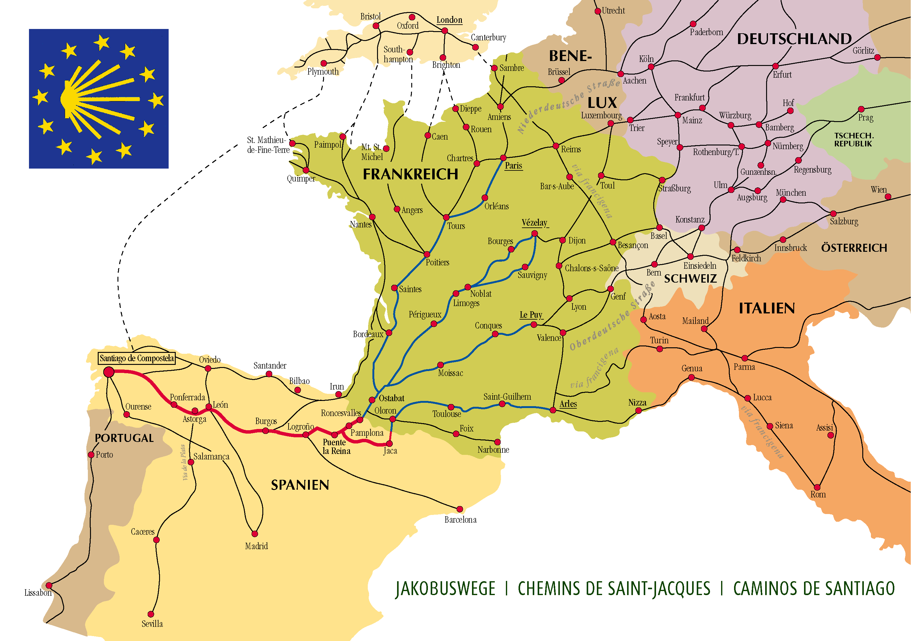
Camino de Santiago – the way of St. James
Notes:
The quote from Pope Benedict came from an address given during a visit to a place called Santiago de Compostela. Has anyone heard of that place before? It’s the site of a pilgrimage called the ‘Camino de Santiago’. Here is a short video to explain…

Slide 9
WHAT IS A PILGRIMAGE TO Santiago de compostela ?
THIS VIDEO IS AN INTRODUCTION ON THE PILGRAMAGE SANTIAGO DE COMPOSTELA.
IF YOU PREFER TO USE YOUR OWN OR SPEAK PERSONALLY PLEASE FEEL FREE.
Notes:
https://www.youtube.com/watch?v=PeQAYiP3Cj0

Slide 10
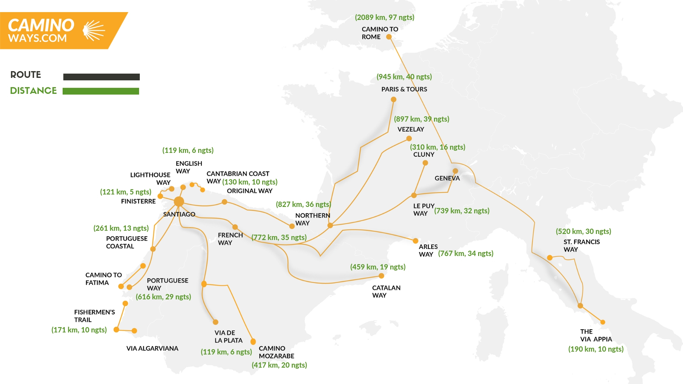

Slide 11
Camino de Santiago – The Way of St James
The Way of St James is a series of pilgrimages and shrines across Europe leading to the town of Santiago de Compostela in northern Spain where the remains of the apostle James are buried.

Slide 12
Activity
In small groups, come up with a list of items you would bring with you if you were walking the Camino and why. Feedback to the rest of the group.
Notes:
In small groups, come up with a list of items you would bring with you if you were walking the Camino and why. Feedback to the rest of the group.
The next slides will show items that pilgrims actually do take on the Camino...

Slide 13
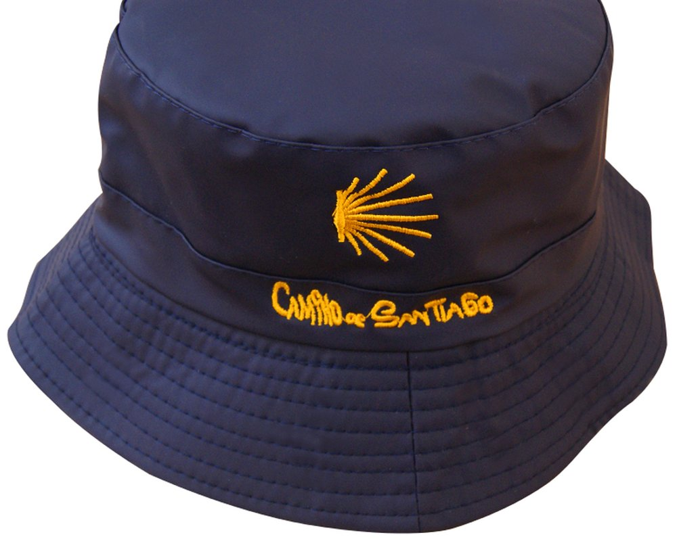
The Hat
As you can imagine, pilgrims walking for long hours under the Spanish sun can get easily sunburned if not using proper protection, so this is the main reason why it became a tradition for pilgrims to wear it.
Nowadays, you don’t only see the traditional hat along the way, people wear baseball caps and all types of summer hats to protect them from the sun.

Slide 14
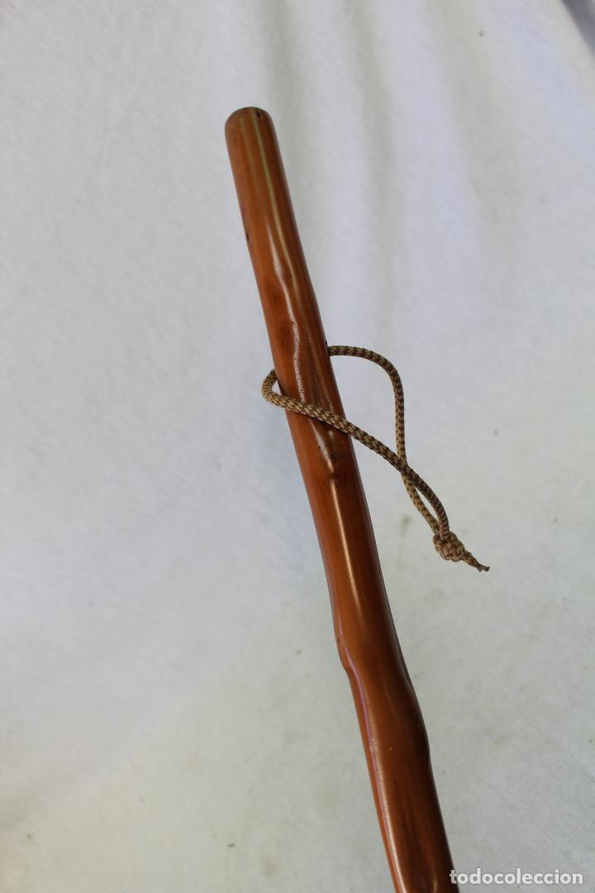
A Wooden Stick or “Bordón”
From ancient times, pilgrims were recognised for the wooden stick they carried which helped to relieve the impact on their knees when walking.
Nowadays, the traditional wooden stick (“bordón” or “cayado”) has been replaced by all types of advanced modern sticks.

Slide 15
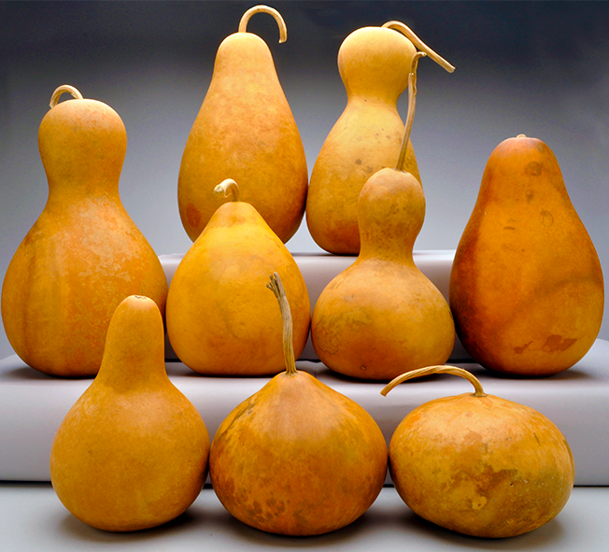
Gourd
Why would you carry a vegetable on the Camino?
In the past, pilgrims used a gourd as a tool to carry water, they would attach them to their walking sticks. It was a light, practical and cheap way to stay hydrated along the way. Nowadays, people still hang gourds from their walking sticks symbolically.

Slide 16
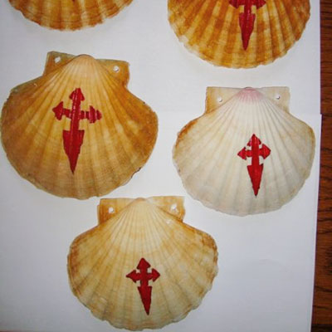
Scallop Shell
The scallop is a very famous symbol associated with the Camino. It is printed on hundreds of milestones showing the way to Santiago.

Slide 17
Scallop Shell
There are several different theories of its origin:
Pilgrims used them to drink water at wayside shrines
St James healed someone’s throat by touching it with a shell.
The lines on the shell symbolise the different routes of the Camino coming together at Santiago

Slide 18
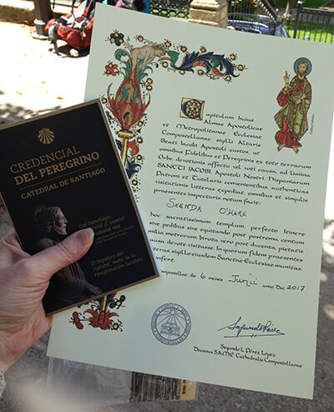
The pilgrim’s passport
The Pilgrim’s Passport is how people prove that they have completed their pilgrimage. Pilgrims must collect stamps in it on the different stages of their journey.
At the end, if you can prove that you have walked over 100km to reach Santiago, you will receive a certificate.

Slide 19
Discussion time
Can you think of any items you've used so far on your FIA journey?
Do you think the FIA award itself is an item on your journey through life?
Talk to the people around you about the work you've been doing so far.
Write in your journal about the work you have done.

Slide 20
Discussion time
Can you think of any examples of people who went on long/hard journeys throughout their lives?
Here is an example from history…

Slide 21
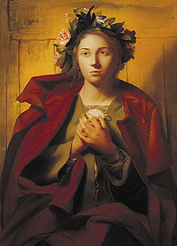
St Bona of Pisa
Born ~1156 in Pisa, Italy.
Died ~1207 in Pisa.
Patron saint of travellers, and specifically couriers, guides, pilgrims, flight attendants, and the city of Pisa.

Slide 22
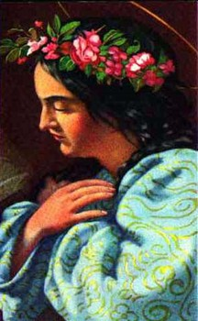
St Bona of Pisa
Born in Pisa, she is reported to have experienced visions from an early age.
On one occasion, the figure on the crucifix at the Holy Sepulchre church held out his hand to her.

Slide 23
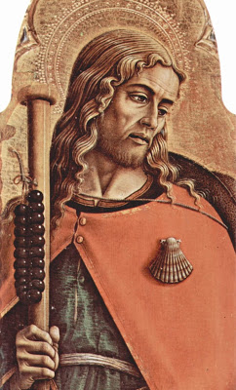
St Bona of Pisa
At another church, she saw a vision of Jesus, the Virgin Mary, and three saints, including James the Greater. She was frightened by the light around these figures, and ran away. James followed her, and led her back to the image of Jesus. Bona observed a very pronounced devotion to James for the rest of her life.
St James the Greater

Slide 24
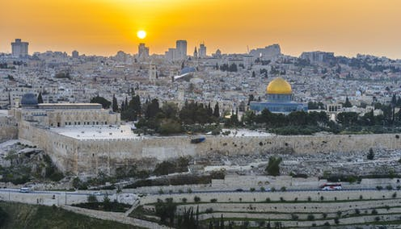
St Bona of Pisa
By the age of ten, she had dedicated herself as a nun. She regularly fasted taking only bread and water three days a week.
Four years later, she made the first of her many journeys, going to see her father who was fighting in the Crusades near Jerusalem.

Slide 25
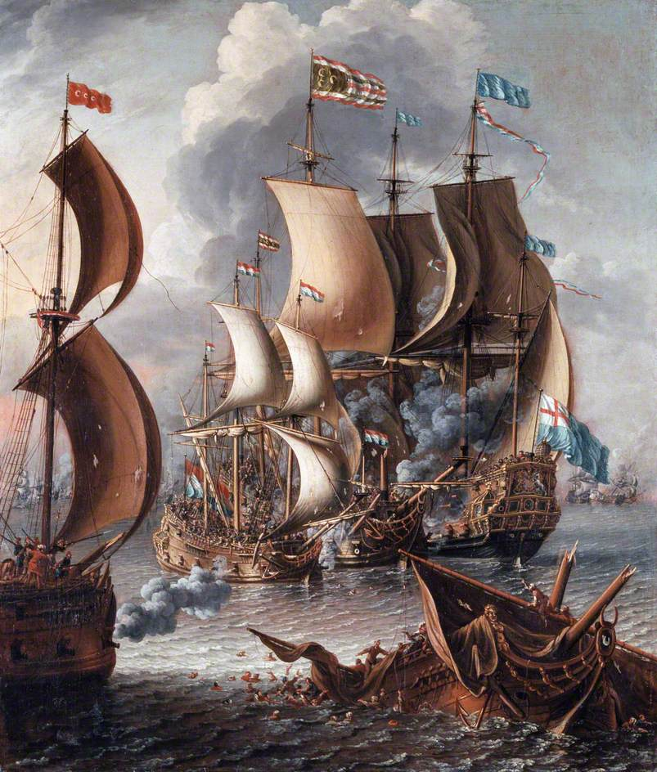
St Bona of Pisa
On her trip home, she was captured by Muslim pirates on the Mediterranean Sea, wounded, and imprisoned.
She was later rescued by some of her countrymen and completed her trip home.

Slide 26
St Bona of Pisa
Shortly after, she set out on another pilgrimage, this time leading a large number of pilgrims on the long and dangerous thousand-mile journey to Santiago de Compostela.
After this, she was made one of the official guides along this pilgrimage route by the Knights of Saint James.

Slide 27
St Bona of Pisa
She successfully completed the trip nine times. Despite being ill at the time, she took and completed a tenth trip, and returned home to Pisa, dying shortly after in the room she kept near the Church of San Martino in Pisa, where her body has been preserved to this day.

Slide 28
“To go on pilgrimage is not simply to visit a place to admire its treasures of nature, art or history.”
Notes:
Although the journeys St Bona made throughout her life were extremely long and arduous, we do not have to walk thousands of miles to make a pilgrimage. If you remember what Pope Benedict said: “To go on pilgrimage is not simply to visit a place to admire its treasures of nature, art or history.” A pilgrimage doesn’t have to be a physical journey, it can be a spiritual one too. You are all too young to be walking the Camino, but you can still seek God where you are right now. Our entire lives can be a spiritual pilgrimage. And the FIA Award can help us on our journey. As we said earlier, much like the items the pilgrims carry on the Camino, the FIA award can be an ‘item’ we carry with us to help us seek the Lord throughout our lives.

Slide 29
Reflection
Do you think you’ve been on any pilgrimages in your life?
How have you encountered the Lord on your journey?
Notes:
Do you think you’ve been on any pilgrimages in your life? How have you sought the Lord? Look back on notes you made earlier. Do you think your time doing the award has been a pilgrimage? Have you sought and found God in the actions that you’ve done?

Slide 30
Go Forth
Simply go on a short walk around your home/school/church. Either alone or with friends. As you do, reflect on what it means to go on a pilgrimage, and how God is always with us on our journey through life.
Notes:
Hand out prayer cards to help with focused reflection on walk.

Slide 31
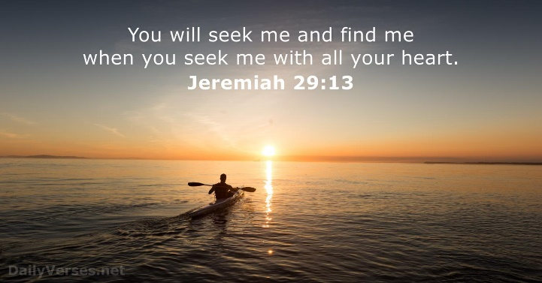
Notes:
Prayer cards if needed.

Slide 32
Let us pray…
God our Father,​
We thank you for the gift of your love which you give every person in the world. We thank you that because of your love we are never alone and should never feel afraid.​
We thank you for the gift of faith which allows us to know you, one God three persons. We thank you that because of that faith the whole of our lives are directed to living for other people.​
Through your son, Jesus Christ, our friend and brother, you show us how to love.​
Give us strength we need to live lives of love and faith, so that the world may come to know your son more and more through our actions and words as we seek to live lives which help to build your kingdom here on earth.​
We ask this through Christ, our Lord. Amen

