Slide 1
LOURDES PILGRIMAGE
REFLECTION POINT (SILVER /GOLD)
“But whoever drinks the water I give them will never thirst. Indeed, the water I give them will become in them a spring of water welling up to eternal life.” John 4:14

Slide 2

In small groups, each person takes it in turns to say three things, two of them being true and one being a lie. The rest of the group must guess which is the lie.

Slide 3
What does the Church say about pilgrimage?
“Pilgrimages evoke our earthly journey toward heaven and are traditionally very special occasions for renewal in prayer. For pilgrims seeking living water, shrines are special places for living forms of Christian prayer in ‘in Church’.”
CCC 2691

Slide 4
What does the Church say about pilgrimage?
“To go on pilgrimage is not simply to visit a place to admire its treasures of nature, art or history. To go on pilgrimage really means to step out of ourselves in order to encounter God where he has revealed himself, where his grace has shone with particular splendour and produced rich fruits of conversion and holiness among those who believe. ”
Pope Benedict XVI
Apostolic Journey to Santiago de Compostela and Barcelona
(6-7 August 2010)

Slide 5
LOURDES
What is Lourdes?
Have you or anyone you know been before?
Why do people go?
Notes:
What is Lourdes? Has anyone been before? Does anyone know why people go on pilgrimages there?
Discussion.

Slide 6
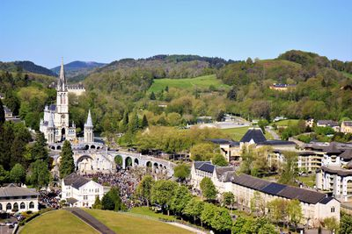
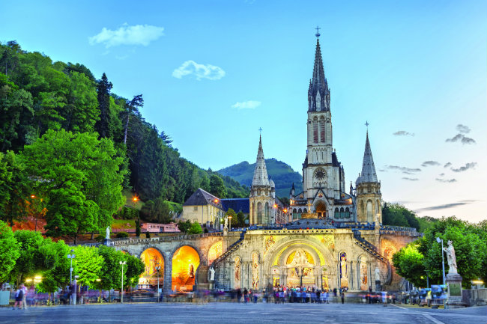
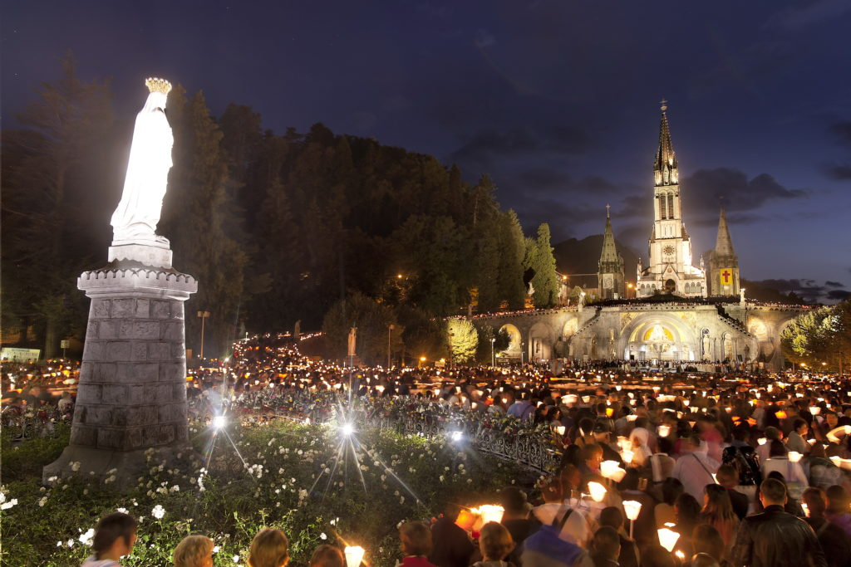
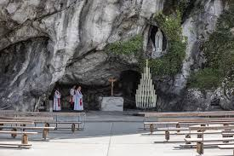

Slide 7
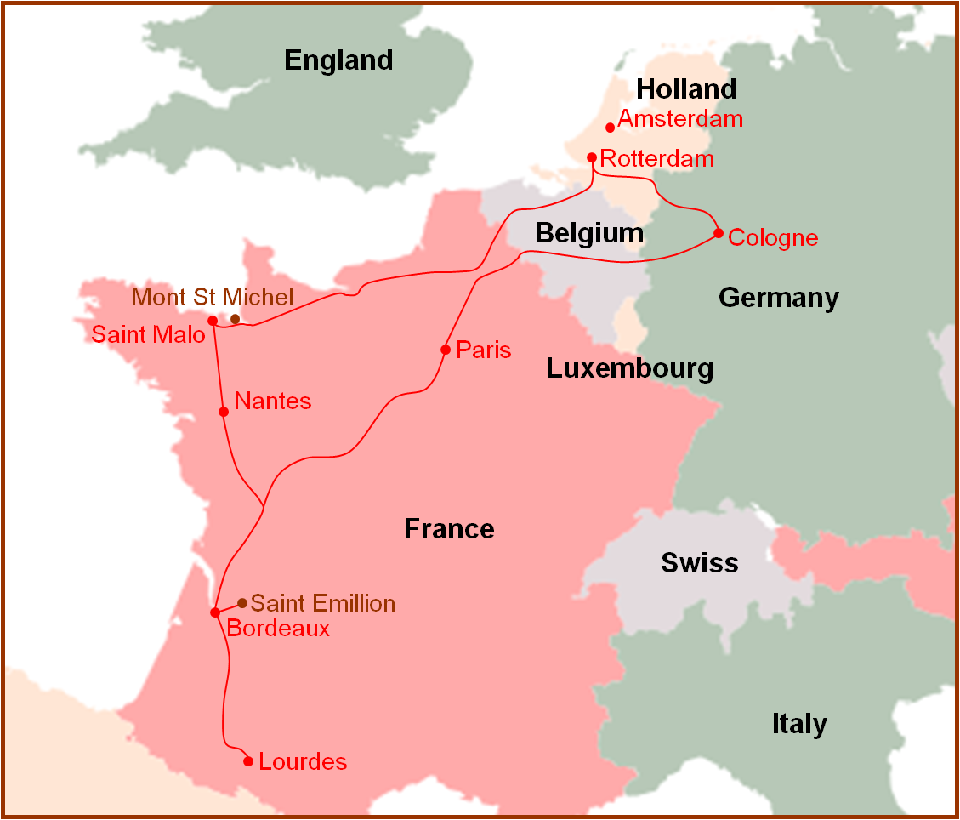
The Story of Lourdes

Slide 8
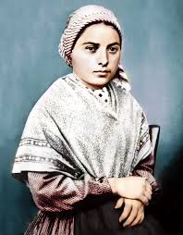
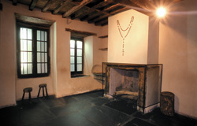
Bernadette Soubirous was born in Lourdes on 7th January 1844. The eldest of nine children, her family lived in an old disused prison cell in considerable poverty. She always had poor health and so spent a lot of time living with her aunt in Bartres (3km away) where she helped to look after sheep.
At the time of the apparitions, in February 1858, Bernadette was 14 and had just returned to Lourdes to prepare for her First Communion.

Slide 9
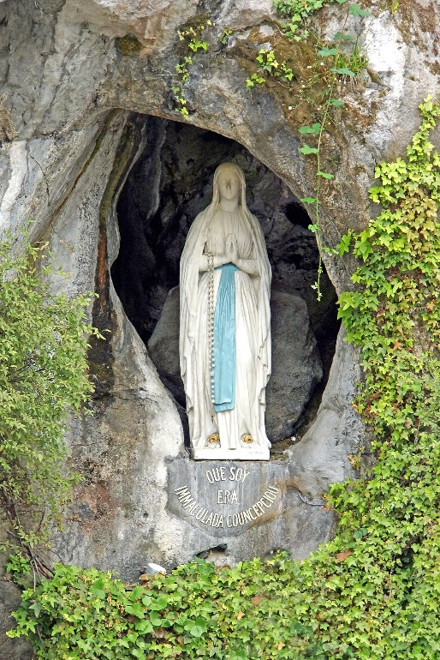
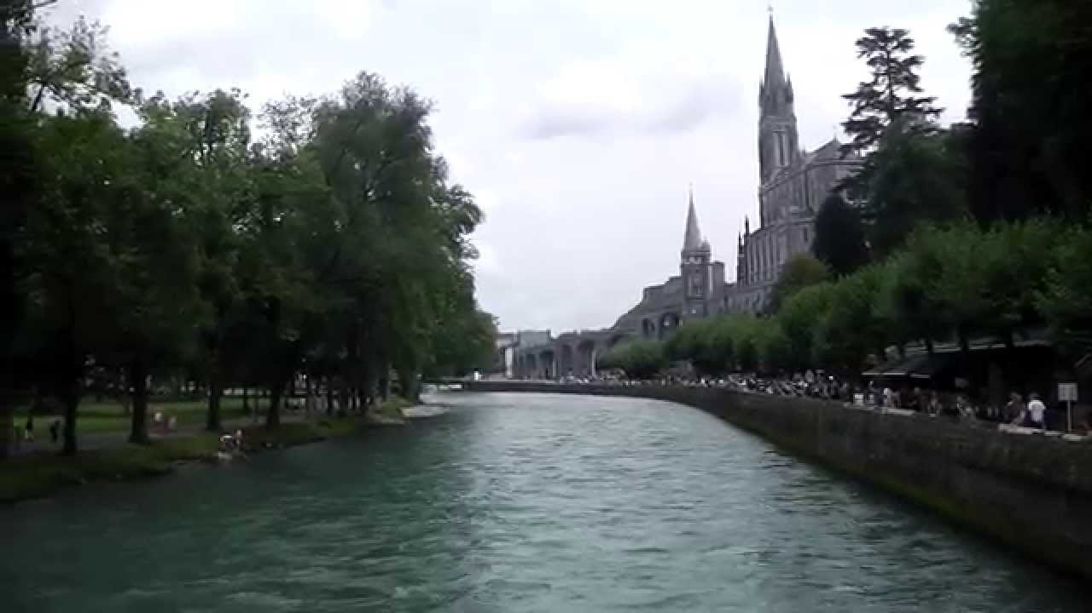
On 11th February, Bernadette was with her younger sister and her friend collecting firewood when she saw a vision of a lady dressed in white at the nearby grotto. She said the rosary and the vision remained until she was done.
Three days later, she returned and sprinkled holy water at the lady who smiled in return.

Slide 10
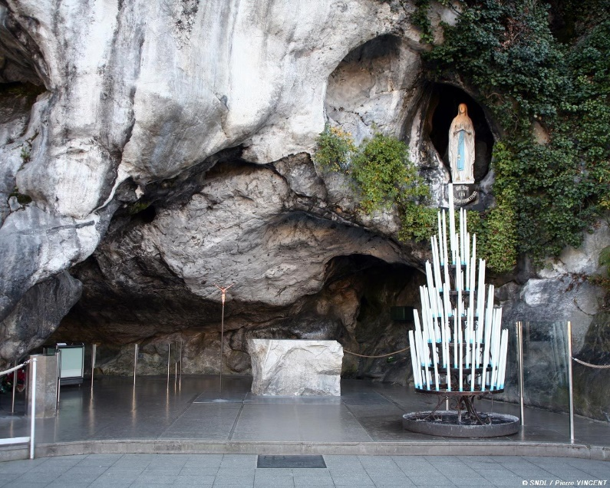
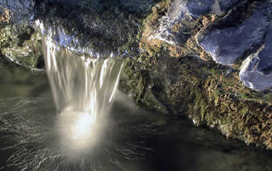
The following Thursday the lady spoke and asked Bernadette if she would return to the grotto every day for fifteen days.
On the 25th, Bernadette behaved strangely. She scraped the ground and tried to drink as the lady had told her to ‘drink at the spring’. By the next day there was a steady flow of water there.

Slide 11
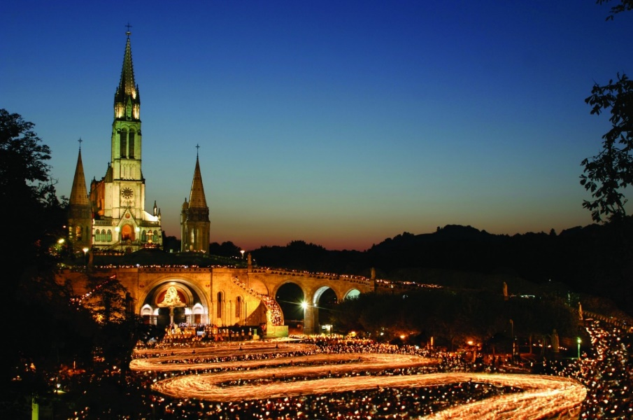
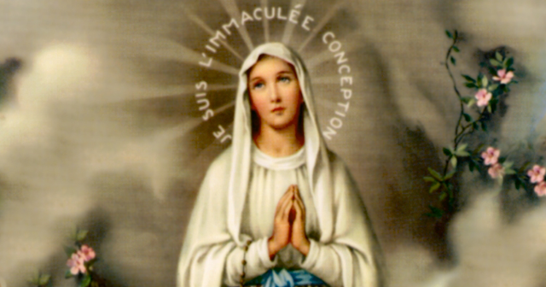
In later apparitions the lady commanded Bernadette ‘go and tell the priests to build a chapel here and come here in procession.’
When Bernadette asked the lady her name, she replied “I am the Immaculate Conception.”

Slide 12
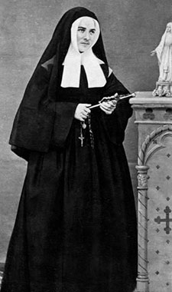
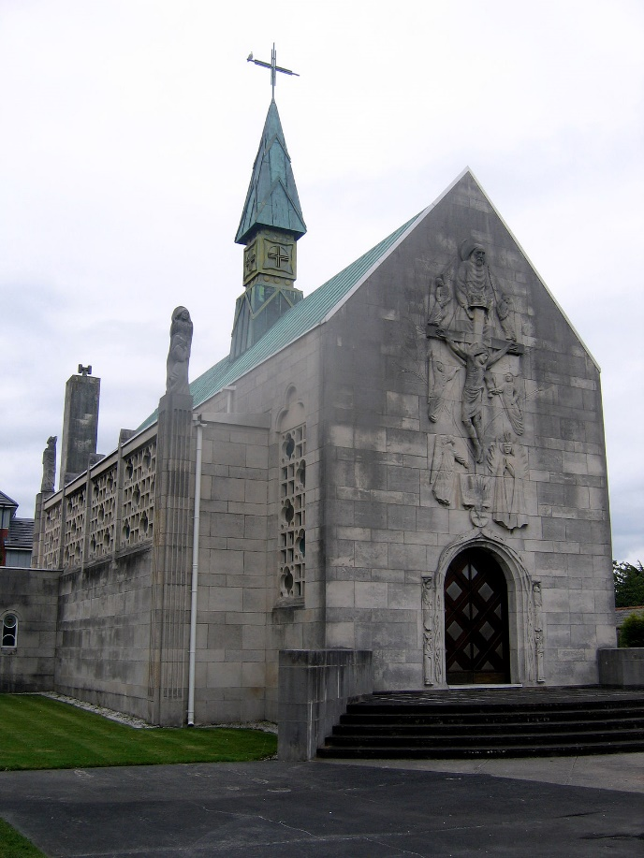
After the apparitions, Bernadette moved to the town of Nevers, where she became a nun.
Meanwhile the Church declared that the events at Lourdes were worthy of belief and a chapel was built near the grotto.

Slide 13
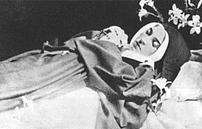
Bernadette suffered ill health for the rest of her life, but was an example of holiness to all, which led to her eventual canonisation.
She passed away in 1879 at the age of 35.
She was declared blessed in 1925 and a saint in 1933.

Slide 14
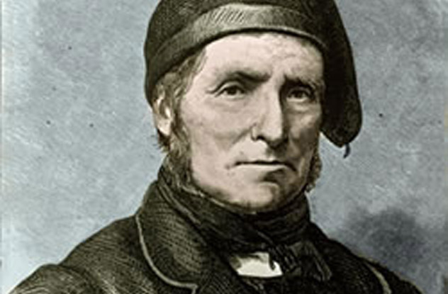
Miracles at Lourdes
Hundreds of miraculous cures are attested to happen in Lourdes every year.
The first is said to be that of Louis Bouriette.
26th February 1858, the day after the spring appeared, Bouriette, who was blind in one eye, bathed his eye in the water and was miraculously cured.
There have been physical and spiritual cures there ever since.

Slide 15
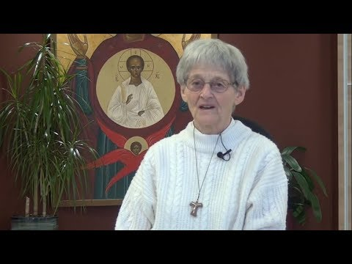
Lourdes recognises 70th Miraculous healing
Notes:
The most recent miraculous cure at Lourdes - https://www.youtube.com/watch?v=1Frra-fxIVI

Slide 16
Reflection Time
Take some time to research a cure that has happened at Lourdes? How does it make you feel?
Whether you have been to Lourdes or not, has there ever been a time where you believe the Lord has healed you? Physically or spiritually.

Slide 17
LIVERPOOL TO LOURDES –
YOUTH PILGRIMAGE

Slide 18
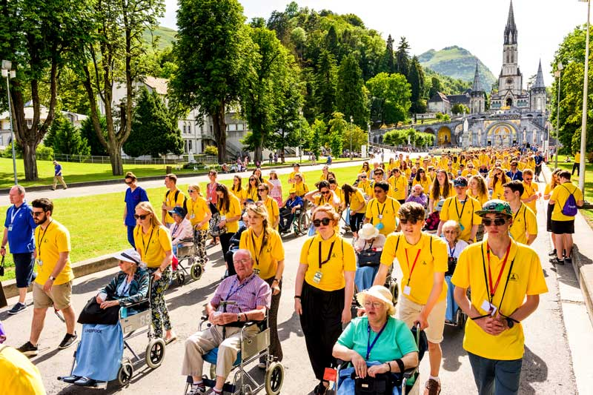

Liverpool Youth Pilgrimage to LOURDEs
Each year, around 1000 people from the Archdiocese of Liverpool travel to Lourdes on a pilgrimage. The pilgrimage consists of people of all ages seeking God. The assisted pilgrims, and the young people who help them every day.

Slide 19

What does Lourdes mean to someone/people who go on the youth pilgrimage?
Notes:
https://www.youtube.com/watch?v=L6uqHr0B9M8&t=1s

Slide 20
Go FORTH
Organise a fundraiser for your local coach/assisted pilgrims.
Apply to go to Lourdes yourself.
Encourage other people to go.

